Slide 1
“DATA MINING BASED RISK ESTIMATON OF ROAD ACCIDENTS”
SAPTHAGIRI COLLEGE OF ENGINEERING
Department of Information Science and Engineering
Project Seminar
on
Under the guidance of
DR H.R RANGANATHA
HOD,DEPT OF ISE
Presented By
Harshavardhan Nagnath Kachare 1SG15IS047
Harshitha D 1SG15IS048
Anvitha BG 1SG15IS023
Chaitra V 1SG15IS039

Slide 2
CONTENTS
1.Introduction
2.Literature Survey
3.Architecture diagram
4.Requirements Specification
5.Design
6.Implementation
7.Testing
8.Results
9.Conclusion
10.Future Enhancement

Slide 3
INTRODUCTION
Road accidents are the main cause of death across the world.
Our aim is to analyse various factors contributing to the accidents and how to deal with them.
Knowing the accident risk at various locations will help the government to take appropriate measures.

Slide 4
OVERVIEW
Road accidents are unquestionably the most frequent cause of damage. It’s one of the most significant causes of the fatalities. The reasons for this are the extremely dense road traffic and the relatively great freedom of movement given to drivers. Accidents that involve heavy goods vehicles (like Lorries, trucks) and even the commercial vehicles with the public transportations like buses are one of the most fatal kinds of accidents that occur, claiming the lives of innocent people. Road accidents are unquestionably the most frequent cause of damage.

Slide 5
PROBLEM STATEMENT
The main objective of the project is to develop a model that mines valuable information from the given data that can be used to solve problems so that it can help to curb accidents. The previous historical data is used to solve these problems.
We develop a model that performs the data mining on the data. Performing clustering to predict risk on Data Mining Based Risk Estimation of Road Accidents various areas of Bengaluru and association rule mining for finding interesting patterns from the data and other analytics in order to help the data analyst of RTO and other sectors.

Slide 6
LIMITATIONS
Data Acquisition: Machine Learning requires massive data sets to train on, and these should be inclusive/unbiased, and of good quality. There can also be times where they must wait for new data to be generated.
Time and Resource: ML needs enough time to let the algorithms learn and develop enough to fulfil their purpose with a considerable amount of accuracy and relevancy. It also needs massive resources to function. This can mean additional requirements of computer power.

Slide 7
LITERATURE SURVEY
SL.No | Title of The Paper | Authors/Year of Publication | Idea or Concept Extracted | Limitations Identified
1 | Data Mining approach to analyse road accident in India | Ayushi Jain, Garima Ahuja, Anuranjana, Deepti Mehrotra 2016 | Using cluster analysis for classifying data based on several accidental factors. | Proposed model has not focused on identifying the accident frequency
2 | Prediction of the cause of accident and accident prone location on roads using data mining techniques | Gagandeep Kaur, Harpreet Kaur 2017 | Co relation analysis and exploratory visualization techniques | Proposed model has not focused on exposing key trends and hidden patterns.
3 | A Data Mining framework to analyse road accident data | Sachin kumar,Durga toshniwal 2015 | Applying associate rule mining on clusters to identify the circumstances associate with accident | No proposed model to estimate probability of risk value.
4 | Safety related problems of Transport system and their solutions | Irina Makarova Anton pashkevich 2018 | Prevention and post accident clean –up like emergency services | Heterogeneity of data makes it difficult to apply for EDS.

Slide 8
ARCHITECTURAL DIAGRAM OF EXISTING SYSTEM
OBTAINING DATASET
FORMING CLUSTERS
DATA PREPROCESSING
REQUIRED DATASET
DATA VISUALIZATION

Slide 9
ARCHITECTURAL DIAGRAM OF PROPOSED SYSTEM
OBTAINING DATASET
FORMING CLUSTERS
RISK ESTIMTION
DATA PREPROCESSING
REQUIRED DATASET
DATA VISUALIZATION
ASSOCIATION RULE MINING

Slide 10
REQUIREMENT SPECIFICATION
Hardware Requirements
⦁ Processor : i3 generation and above
⦁ Speed : 2.6 GHz and above
⦁ RAM : 3GB
⦁ Hard Disk : 20 GB
Software Requirements
⦁ Operating System : Windows 7 and above
⦁ Application : Anaconda distribution python 3.6 and above
⦁ Front End : Tkinter module for python
⦁ Script : Python.
⦁ Development environment : Spyder IDE
⦁ Datasets : MS EXCEL less than 2016

Slide 11
FUNCTIONAL REQUIREMENTS
Risk Estimation Module
The model is first trained and once the training is completed the system replies with a finished clustering message and the submit button appears on screen.
Select the desired area and time categories to know the risk of accidents i.e High or Low.
Analytics Module
This module mainly provides the trend analysis of the specific selected area.
There are also other sections such as causes, condition vehicle type, hospital and road conditions.
Reporting Anonymous Accidents
Report any accident anonymously without having to provide their identity.
A form will be displayed where he we have to enter the date, time, location, type of vehicle, type of accident, number of casualties and vehicle number.
Association Rule Mining
User providing rules for the given support and confidence values based on which rules are mined and displayed.

Slide 12
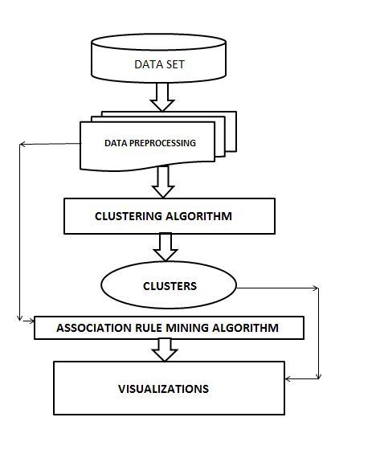
DESIGN
System Design
Figure 1: System Architecture

Slide 13
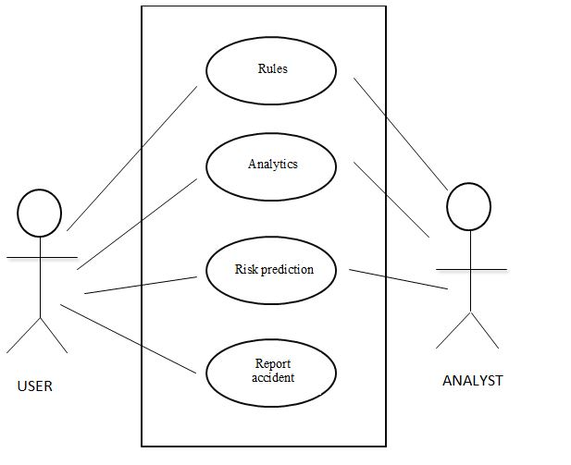
DESIGN
Use Case Diagram
Figure 2:Overall use-case diagram

Slide 14
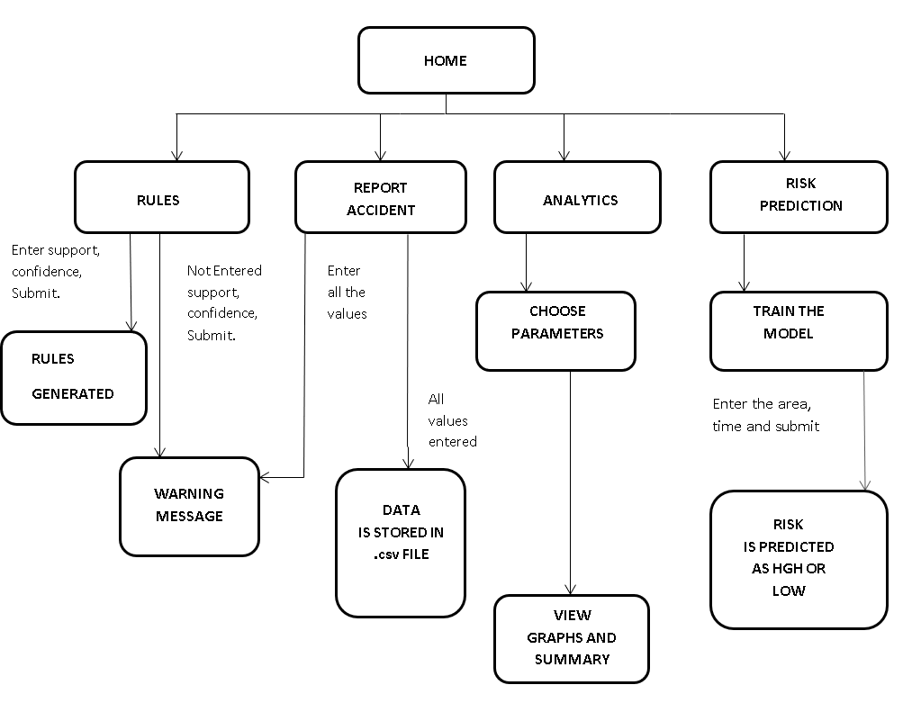
DETAILED DESIGN
Activity Diagram
Figure 3:Overall Activity Diagram of the System

Slide 15
IMPLEMENTATION
Association Rule Mining
Step 1: let support and confidence be two input variables
Step 2: read the csv file on which rule mining is done and store it in a data frame using pd.read_csv()
Step 3: preprocess data by performing feature selection
Step 4: compute association_rules by applying apriori algorithm with input values of min_support,min_confidence and min_lift=1.0
Step 5: store the association results as a list of association_rules
Step 6: for item in association results do append rules as item -> item [0]
Step 7: print the rules as computed when clicked on the mine button

Slide 16
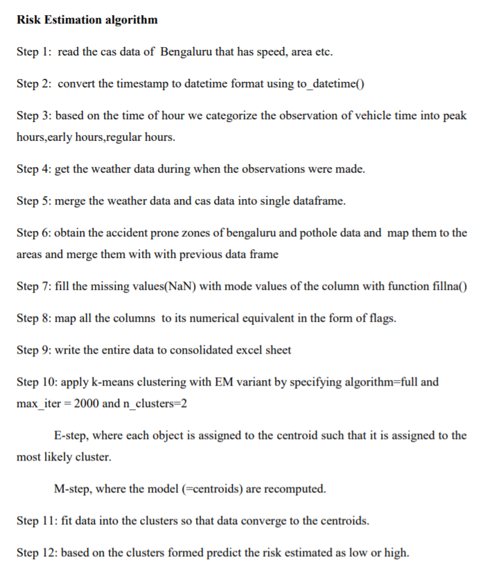
IMPLEMENTATION

Slide 17
TESTING
Serial no. | Test case | Input | Excepted output | Actual output | Remarks
1 | Test case for Rule module | Valid support and valid confidence | Rules are generated | Rules are generated | PASS
2 | Test case for Report accident module | Valid values for fields in the form | Data added to data.csv file | Data added to data.csv file | PASS
3 | Test case for graph module | Select graph to be generated | Graph will be displayed | Graph will be displayed | PASS
4 | Test case for risk estimation module | Select area and time for risk estimation | Risk will be estimated | Risk will be estimated | PASS

Slide 18
RESULTS
We are obtaining the risk estimation model that will give details about the risk at various locations of Bengaluru based on the most important parameters and it is depicted in the form of low and high risk.
Rule mining model will help to identify the most important attributes within a factor that is responsible for accidents based on the given data set in the form of rules.
Anonymous entry for new accidents to be stored and used for further data mining.

Slide 19
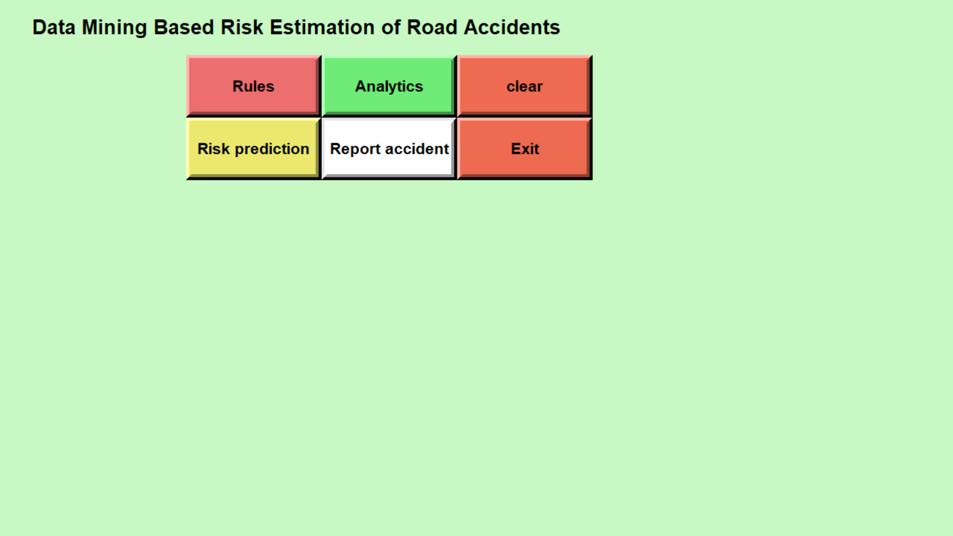
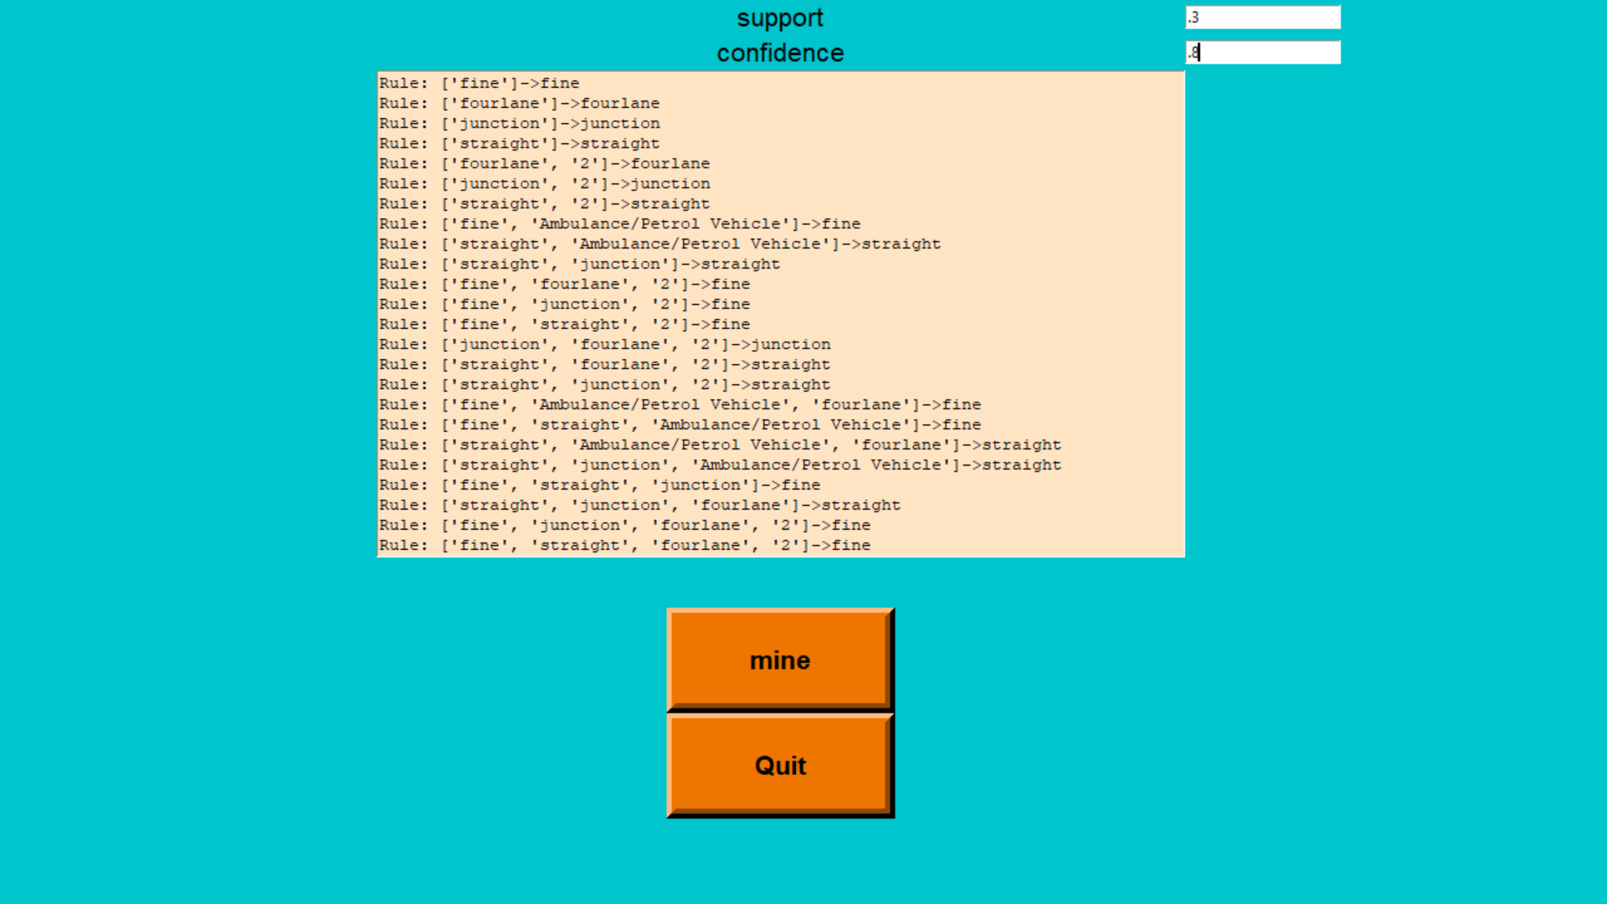
SNAPSHOTS
HOMEPAGE
RULE MINING

Slide 20
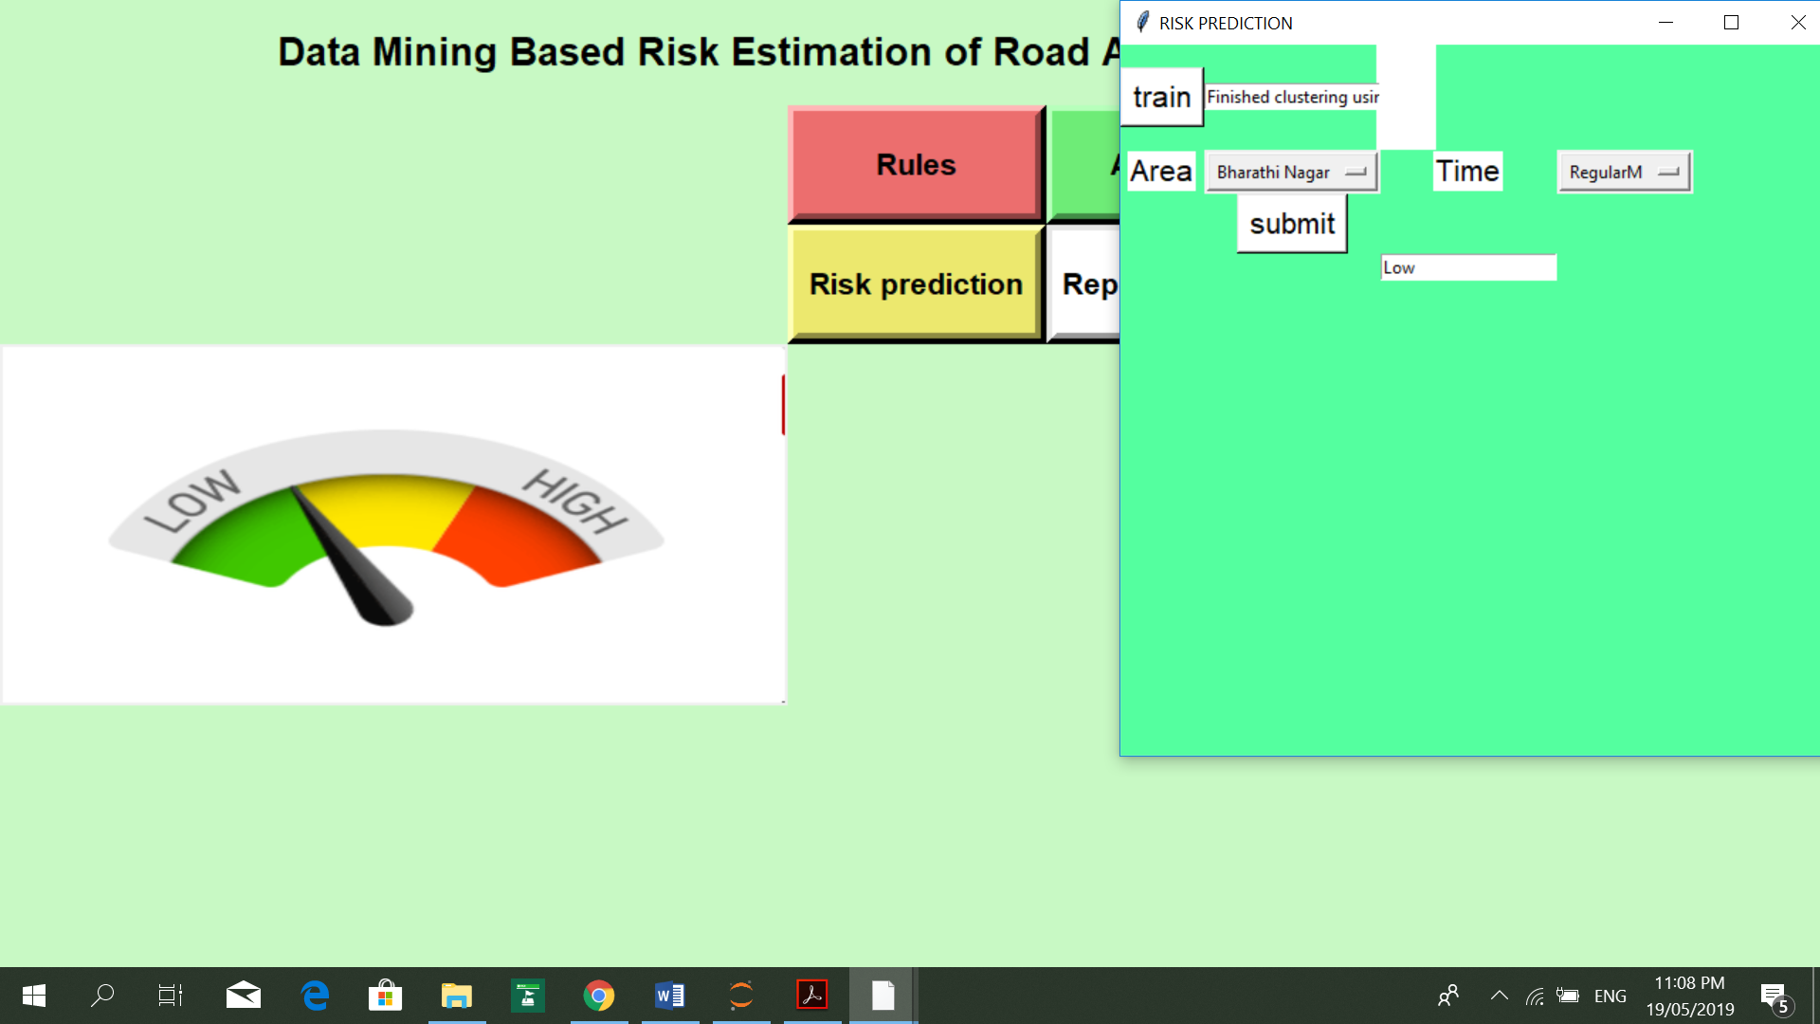
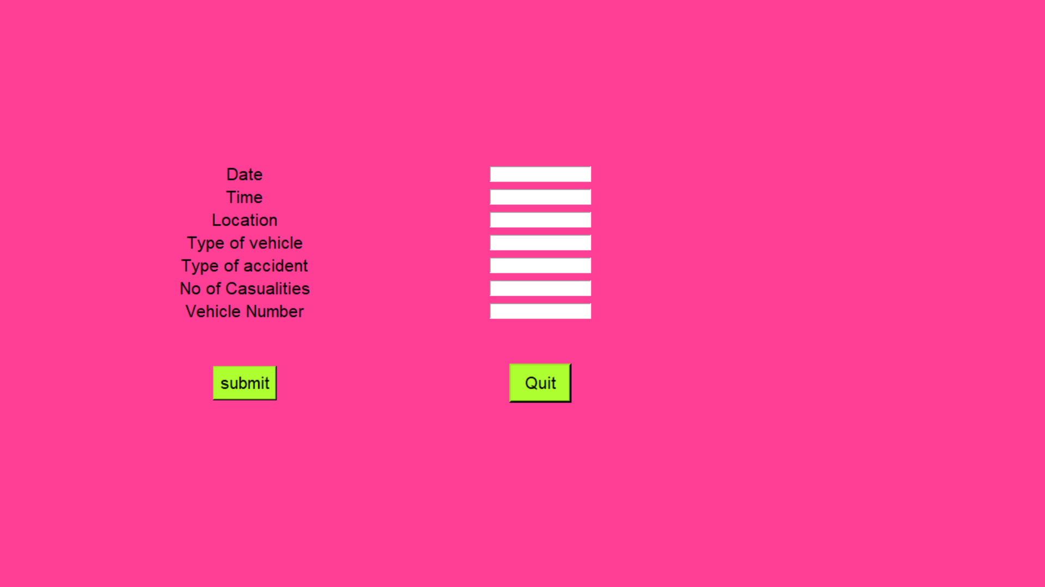
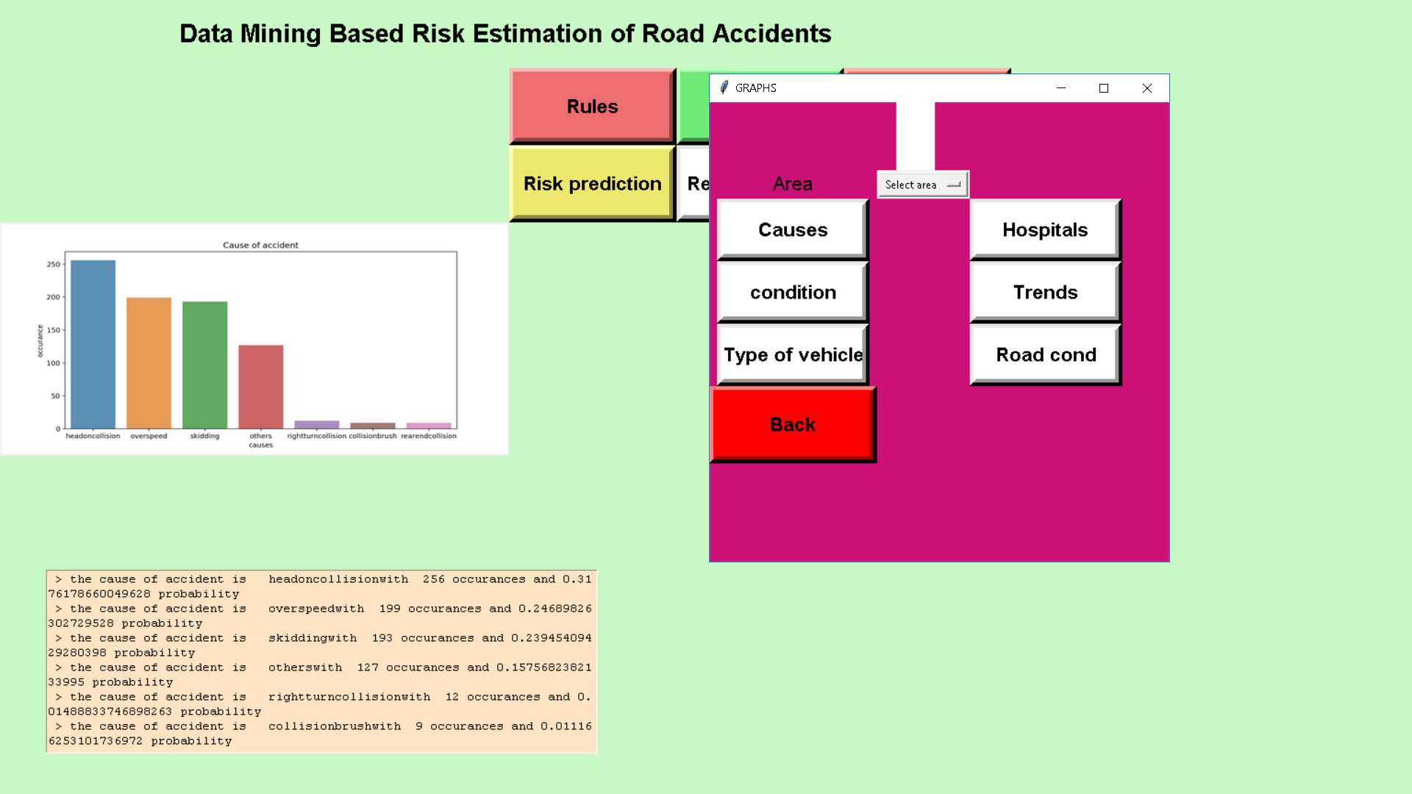
RISK ESTIMATION
REPORT ACCIDENT
ANALYTICS

Slide 21
CONCLUSION
Cluster analysis helps in determining the accident prone zones in Bengaluru by estimating the risk as low and high based on various factors.
We apply rule mining apriori algorithm to determine various factors that occur together and are mainly responsible for causing accidents.
The given insights about accidents can help to reduce them.

Slide 22
FUTURE ENHANCEMENT
In the future one can try to improve the efficiency of the model and try to take preventive measures to reduce the accidents.
Develop an automatic emergency alarm response system.
Expand the model to data mining of other regions.

Slide 23
THANK YOU

